Slide 1
Object Oriented Systems Analysis & Design using Java & UML
Lecture 3 : Polymorphism

Slide 2
Lecture Contents
Polymorphism
  Java Reference Variables
    Reference variables
    New operator
    Pointers
    Garbage collection
  Polymorphism
    Overloading superclass methods
    Create arrays of superclass reference variables
    Dynamic Binding
    Working with the Java Graphics Package
Lecturer: Stephen Sheridan

Slide 3
Java Reference Variables
In Java we cannot access objects directly. We always have to access them through a reference. Suppose for example that we have defined a class called Lift which describes how lifts work. We can then declare a new variable which we will call L1.
  Lift L1;
This does not mean, as we might expect, that the variable L1 is of type Lift. It means that L1 is a reference variable which has the ability to refer to Lifts.
L1 is of type “reference to Lift”.
Lecturer: Stephen Sheridan

Slide 4

Java Reference Variables
Since no initialisation value has been indicated in the declaration, L1 will automatically get a default value null. This means that the variable L1 will not, for the present, be refering to anything.
We could look upon L1 as being a container which contains an empty reference.
Lecturer: Stephen Sheridan

Slide 5
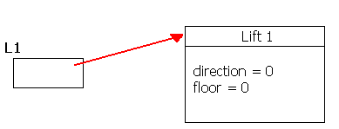
Java Reference Variables
To make a L1 refer to an object, we must create an object, that is, create a new instance of class Lift. This is done with the new operator as we have seen before.
  L1 = new Lift();
Then we will have a situation as shown below:
Lecturer: Stephen Sheridan

Slide 6
Java Reference Variables
It is the reference that is called L1. We can now reach the object through the reference. For example we could tell the lift to go to the 5th floor by calling its goTo method.
  L1.goTo(5);
Naturally it is possible to initialise reference variables directly at the point of declaration.
  Lift L2 = new Lift();
We now have two reference variables and two lifts.
Lecturer: Stephen Sheridan

Slide 7
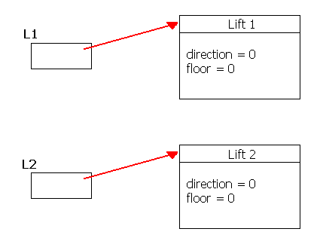
Java Reference Variables
Lecturer: Stephen Sheridan

Slide 8
Java Reference Variables
When we use new the Java system reserves memory space for the new object. The space for objects no longer in use must be returned so that memory space will not be exhausted.
In some programming languages, such as C++, a programmer had to take great care that this was done correctly, however in Java this is extremely easy.
WE DO ABSOLUTELY NOTHING !
There is no operator to return memory in Java. The system automatically carries out garbage collection and if it discovers objects without references to them, it will return their memory space to the system.
Lecturer: Stephen Sheridan

Slide 9
Java Reference Variables
If we know that we no longer have need of an object, we can make it possible for the system to return memory space by ensuring that there is no longer a reference to the object.
For example, we can assign the value null to a reference variable.
If we reference variables that are declared in methods we do not have to set them to null because they will cease to exist once the methods has ended.
The Java system will not release memory space as long as there is a reference to it.
Lecturer: Stephen Sheridan

Slide 10
Java Reference Variables
Automatic garbage collection is naturally very convenient for the programmer. There is only one disadvantage; it can take time. This means that Java is not always the correct language to choose for all types of applications. For example, real time systems.
It is often asserted that there are no pointers in Java but this is not true. In fact, it could be said that the opposite is nearer to the truth. As soon as you start creating and using objects you are working with pointers, for reference variables are nothing other than pointers.
When people say that there are no pointers in Java, what they really mean is that there are few opportunities for the programmer to manipulate pointers.
Lecturer: Stephen Sheridan

Slide 11
Java Reference Variables
We can also make assignments to reference variables. If we suppose, as previously, that the variables L1, and L2 are references to the class Lift, we can write.
  L1 = L2;
This means that the reference variable L2 will be assigned to the reference variable L1. After the assignment both references will be pointing to the same object.
The object that L2 points to will not be copied to L1.
Lecturer: Stephen Sheridan

Slide 12
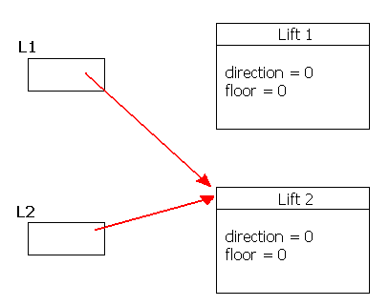
Java Reference Variables
The diagram below shows the result of this assignment.
Lecturer: Stephen Sheridan

Slide 13
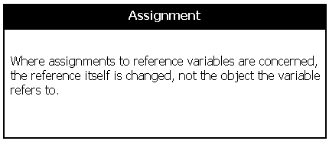
Java Reference Variables
Lecturer: Stephen Sheridan

Slide 14
Polymorphism
When we extend a superclass we can redefine one or some of its methods in the subclass. It can then be said that the new subclass’s method overides the method in the superclass.
In the following example the Java Applet class has been extended by the class Overloader. The Java Applet class has a method called paint which it uses to do any output to the applet window.
If we extend the Java Applet class and do not overload/override the paint method we should get the following output.
Lecturer: Stephen Sheridan

Slide 15
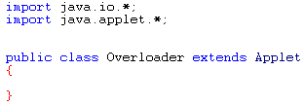
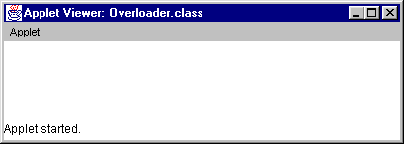
Polymorphism
Code below shows Overloader class.
This should just give us a blank Applet window.
Lecturer: Stephen Sheridan

Slide 16
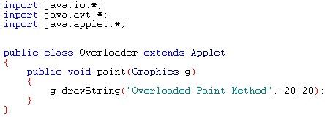
Polymorphism
We can however change this behavior by overloading the Applet paint method in the subclass.
The code above shows the new overloaded paint method in the Overloader class. The next slide shows the output when the applet is run.
Lecturer: Stephen Sheridan

Slide 17
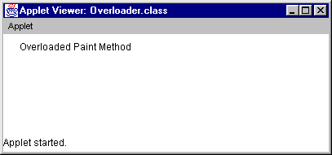
Polymorphism
Lecturer: Stephen Sheridan

Slide 18
Polymorphism
As you can see the overloaded paint method has changed the behavior of the Applet program.
In the first example the paint method was not overloaded so the default paint method in the Java Applet class we called. This default paint method in the superclass does nothing so there was no output. In effect we could think of the paint method in the superclass as having no code in its body.
    public void paint(Graphics g)
    {
      // Do nothing
    }
In the second example we overloaded the paint method and put some code inside it.
Lecturer: Stephen Sheridan

Slide 19
Polymorphism
This is really just a combination of inheritance and method overloading so what has it got to do with polymorphism?
Polymorphism is the ability to treat disimilar but related objects in the same way.
The objects in question can be related through inheritance
The objects in question may be disimilar because they may want to same method to behave in different ways.
Lecturer: Stephen Sheridan

Slide 20
Polymorphism
Lets take a non-software analogy
  When a car driver decides to hit the brakes in order to avoid a pedestrian crossing an intersection, the driver is concerned about the concept of quickly slowing down or braking. The brakes will be either drum brakes or disk brakes, which although constructed quite differently both achieve the same effect of slowing a vehicle down by converting the vehicles kinetic energy to heat. The driver who is about to depress the brake pedal to avoid the pedestrian is not (and should not be) thinking about the drum versus disk implementation of the brake but only of the desired action. The system (the car) determines the how the braking action is to be implemented.
Lecturer: Stephen Sheridan

Slide 21
Polymorphism
Now lets take a software analogy
  Lets say for example we had a superclass called Shape which has a draw method that does nothing. Imagine from this class we specialised and created two more classes called Trianlge and Circle which overload the superclasses draw method.
  These classes are related through inheritance and on inspection seem to have a common need to draw themselves on screen. Just as each implementation of thebraking system has the common goal of slowing the car down. However Triangles look completely different from Circles so the code in each draw method will be different.
  Now lets imagine we had a bag of shapes some of which were Triangles and some of which were Circles. Wouldn’t it be nice if we could just call the draw method for each of the shapes and let the system worry about which implementation of draw was called.
Lecturer: Stephen Sheridan

Slide 22
Polymorphism
Polymorphism is the ability of the system to decide at run time which implementation of draw to call for each shape in the bag.
This ability is called Dynamic Binding
In order to implement polymorphism in Java we need to follow a set of steps.
  Create a superclass with a method to be overloaded in the subclass
  Extend the superclass
  Overload the superclass mehtod
  Create a bag of objects
  Loop through the bag of objects and call the overloaded method
Lecturer: Stephen Sheridan

Slide 23
Polymorphism
So Lets follow the steps and do some Polymorphism
Firstly lets set the scene, imagine we wanted to create an Applet world. Our Applet world is only capable of primitive graphics output of points,lines,rectangles,ovals and text.
Our Applet world is made up of Things. A thing can have a position within the world which is given by an x,y co-ord. A thing within the world can also have a name and a color.
Our world can of course have different types of Things, for example it could contain humans and cats.
Lecturer: Stephen Sheridan

Slide 24
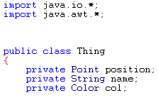
Polymorphism
The following is the source code for our Thing object which will act as our superclass.
NOTE : the Thing class uses the Java’s own Point object and also uses the Java Color Object.
Lecturer: Stephen Sheridan

Slide 25
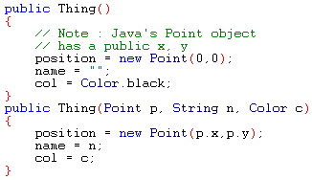
Polymorphism
The Thing class has two constructors
Java’s point object has its x,y as public members so we do not have to call get methods.
Lecturer: Stephen Sheridan

Slide 26

Polymorphism
As usual we have some get methods so we can access the data members of the Thing class.
Lecturer: Stephen Sheridan

Slide 27
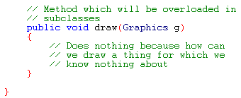
Polymorphism
Finally we have a draw method which does nothing in this class but will be overloaded and given a code body in our subclasses.
Lecturer: Stephen Sheridan

Slide 28
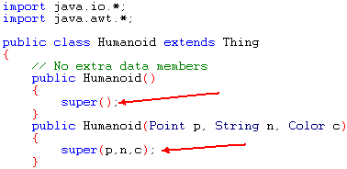
Polymorphism
Next we need to create some subclasses. We will use the Human and Cat suggestion from the previous slide.
As you can see the Humanoid class does not add any extra data members, notice however the calls to super in its constructors.
Lecturer: Stephen Sheridan

Slide 29
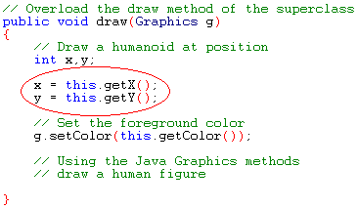
Polymorphism
Next we need to overload the superclasses draw method in order to draw a human figure.
Note the full draw code is not shown here, as a full code printout is included at the end of this lecture.
Lecturer: Stephen Sheridan

Slide 30
Polymorphism
There are a couple of important points to make about the code on the previous slide.
  The position and color in the superclass class were declared as being private so we do not have direct access to them. We must call the superclass access methods in order to get their values.
  The this operator is sometimes used to show that your calling a method that actually belongs to the class your currently working in.
  this means the current instance or the current object.
  You could easily get rid of the this operator and just call the method.
    x = getX();
  The x and y variable are temps, and are only used to store the objects position instead of calling getX and getY everytime we need a co-ord. In other words it just makes the code more efficient and easier to read.
Lecturer: Stephen Sheridan

Slide 31
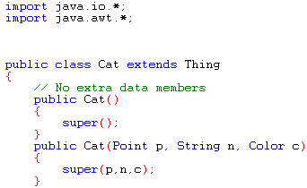
Polymorphism
The following code shows the Cat class
As you can see the Cat class does not add any extra data members, notice however the calls to super in its constructors.
Lecturer: Stephen Sheridan

Slide 32
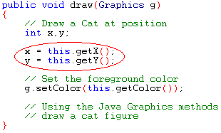
Polymorphism
Next we need to overload the superclasses draw method in order to draw a cat figure.
Note the full draw code is not shown here, as a full code printout is included at the end of this lecture.
Lecturer: Stephen Sheridan

Slide 33
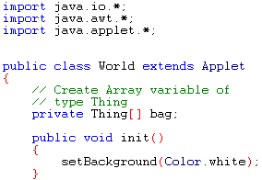
Polymorphism
Now that we have our objects created all we have to do is create a world for them to live in. We can easily do this by extending the Java Applet class.
Lecturer: Stephen Sheridan

Slide 34
Polymorphism
Seeing as though our world will contain Things we will need somewhere to put them. For the moment an array of Thing reference variables will do the job. Later we will limit ourselves to having only six Things in our world.
We have also overloaded the Java Applets init method. This allows us to set the background color of the applet program to white. Think of the init method as allowing us to initialise our canvas before we draw on it.
Java automatically calls this method just like a constructor.
Lecturer: Stephen Sheridan

Slide 35

Polymorphism
Next comes the Worlds constructor. This is very important as we will have to create our bag of Things and create Things to put into the bag.
Firstly we call the superclass constructor by using the super method. Next we create an array of Things. The array contains six Thing reference variables and is called bag.
Lecturer: Stephen Sheridan

Slide 36
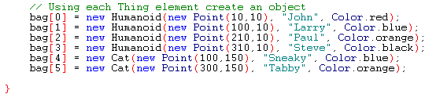
Polymorphism
Now for each of the Thing reference elements in our bag we must create a Thing object.
Notice how instead of creating loads of points and passing them to each constructor we can just pass new Point(10,10) as the parameter instead.
As a new Point will be created there and then it will save us lots of time and effort.
Lecturer: Stephen Sheridan

Slide 37

Polymorphism
Now that we have written the code to create our bag of things all we need to do is overload the Java Applets paint method so that we can display our world of things.
This is where the dynamic binding will happen
To draw all things within our bag of things all we have to do is write a loop which will call draw for each of the bags elements.
Lecturer: Stephen Sheridan

Slide 38
Polymorphism
There are some important points to be aware of before we continue.
  We create an array of Thing references
  Using Thing references we create Humaniod and Cat objects
    Is this ok ?
  The answer is yes because Humanoid and Cat are related to Thing through inheritance. When this occurs we can use a superclass reference variable to refer to any of its subclasses.
    Thing t1 = new Thing();
    Humanoid h1 = new Humanoid();
    t1 = h1; // change what t1 references
    // should call humanoid draw because t1 now points to a humanoid
    T1.draw(g);
Lecturer: Stephen Sheridan

Slide 39
Polymorphism
Lets test our Polymorphic world
We should get four humanoids and two cats displayed in our world.
Lecturer: Stephen Sheridan

Slide 40
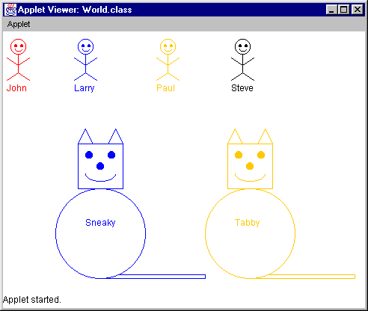
Polymorphism
Lecturer: Stephen Sheridan

Slide 41
Polymorphism
So the decision of which draw method to call is decided by the system based on what the reference variable is pointing at and not on what type the reference variable is.
Lecturer: Stephen Sheridan

